Slide 1
Implementation of NIC E-procurement System (GepNIC)
in
Govt. of NCT of Delhi
Ajay Chagti
Special Secretary(IT)
Government of NCT of Delhi

Slide 2
Over View
Govt. of NCT of Delhi introduced e-procurement system for it’s departments in the year 2008 through DGS&D.
It was decided to implement NIC e-procurement system (GePNIC) in Delhi Government from year 2011 onwards.
GePNIC has been implemented in all Departments / Autonomous Bodies / Institutions of Delhi Government (100 percentage coverage)

Slide 3
Govt. of NCT of Delhi eProcurement System
(https://govtprocurement.delhi.gov.in)
Delhi Govt has made it mandatory for all Departments for procurement (of Goods, Work & Services ) to be done on NIC E-procurement system (GepNIC)
The site for Delhi Government e-Procurement portal was launched by NIC on 01/04/2011
All Tenders for value of Rupees 2 Lakh and above are being published through GePNIC.

Slide 4
Vendor Registration Module
Vendor Registration Module exclusively developed for Delhi Govt, through which only the Registered Vendors would be allowed to participate in the e-tendering process.
Registration of Vendor is valid for a period of one year
The Tender Fee is exempted in all Tenders of Govt of NCT of Delhi.
The Vendor Registration module has been integrated with SBI e-payment gateway
Number of Active Bidders/ Vendors : 5,475

Slide 5
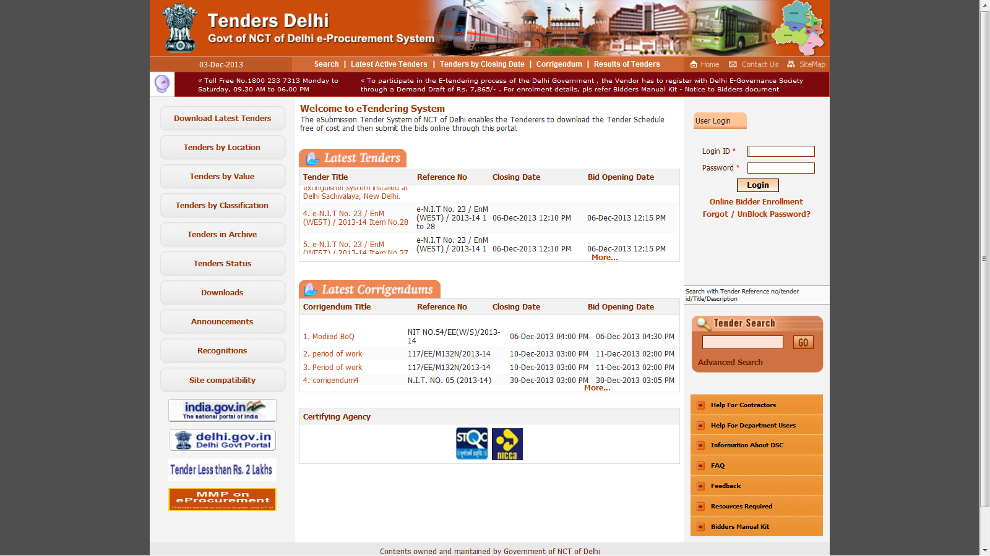

Slide 6
Coverage of NIC e-Procurement System
No. of TIA (Tender Inviting Authorities) of Delhi Govt Deptts/Institutions/Autonomous Bodies using NIC E-proc system : 220
These include major Departments such as:
Public Works Department :- 26 Circles,96 Divisions and 586 Sub Divisions
Delhi Jal Board (DJB) :- 102 Divisions
New Delhi Municipal Council : 20 Divisions and 51 Sub-Divisions
DSIIDC – 66 Divisions
Delhi District Courts – covering 11 District Courts.
Revenue Deptt – covering 11 Districts and 33 Sub-Div. Offfices
Irrigation & Flood Control Dept – 4 Divisions and 18 Sub-Divisions
Health & Family Welfare Department/Delhi Government Hospitals / Institutions.

Slide 7
Delhi eProc System Tender Statistics
SL No | Financial Year | No. of Tenders | Value of Tender (Rs. in Crore)
1 | 2011-2012 | 16,264 | 6,292
2 | 2012-2013 | 24,182 | 12,719
3 | 2013-2014 | 26,378 | 8,114
4 | 2014-2015 | 27,684 | 8,074
5 | 2015-2016 | 26,626 | 12,092
6 | 2016-2017 | 28,472 | 14,128
7 | 2017-18 (upto 31-12-17) | 18,515 | 8,162
 | Cumulative Tenders | 1,68,121 | 69,581

Slide 8
Implementation Strategies Followed
Exclusive Help Desk established for Department officials at Delhi Secretariat
Exclusive Help Desk for Vendors established at Vikas Bhavan- II, Civil Lines
Call Centre Facility
Continuous Training sessions for department officials & Vendors.
Well defined guidelines to adopt/enable Delhi Govt. e-Procurement System

Slide 9
Training & Operational Support
Continuous Training Programs has been conducted for the Delhi Govt. Department officials & Vendors for implementing GePNIC.
No. of Dept. users trained : 5,000 +
Operational Support provided to Vendors over a period of 7years : 25,000 +
Guidelines/ Procedures for implementation of e-procurement system prepared and hosted at Delhi Government Web site

Slide 10
Implementation - Success Factors
Strong will and focused thrust from the top management
Dedicated Help Desk team to drive the Project
Help Desk Activities include Daily checking of all published tenders
Deficiencies in the Published tenders conveyed to the Dept’s Nodal officer ,through e-Mail & Phone & follow-up done, so that corrective action is taken by the Department
Periodical Analysis & Training for corrective measures being undertaken.
The deficiencies in publishing of tenders has significantly reduced over a period of time.

Slide 11
State Wise Comparision
Based on 2016-2017 data, the state wise comparision of No. of tenders published by Area (sqkm) has been calculated (Annexure-II)

Slide 12
Thank You

